Slide 1



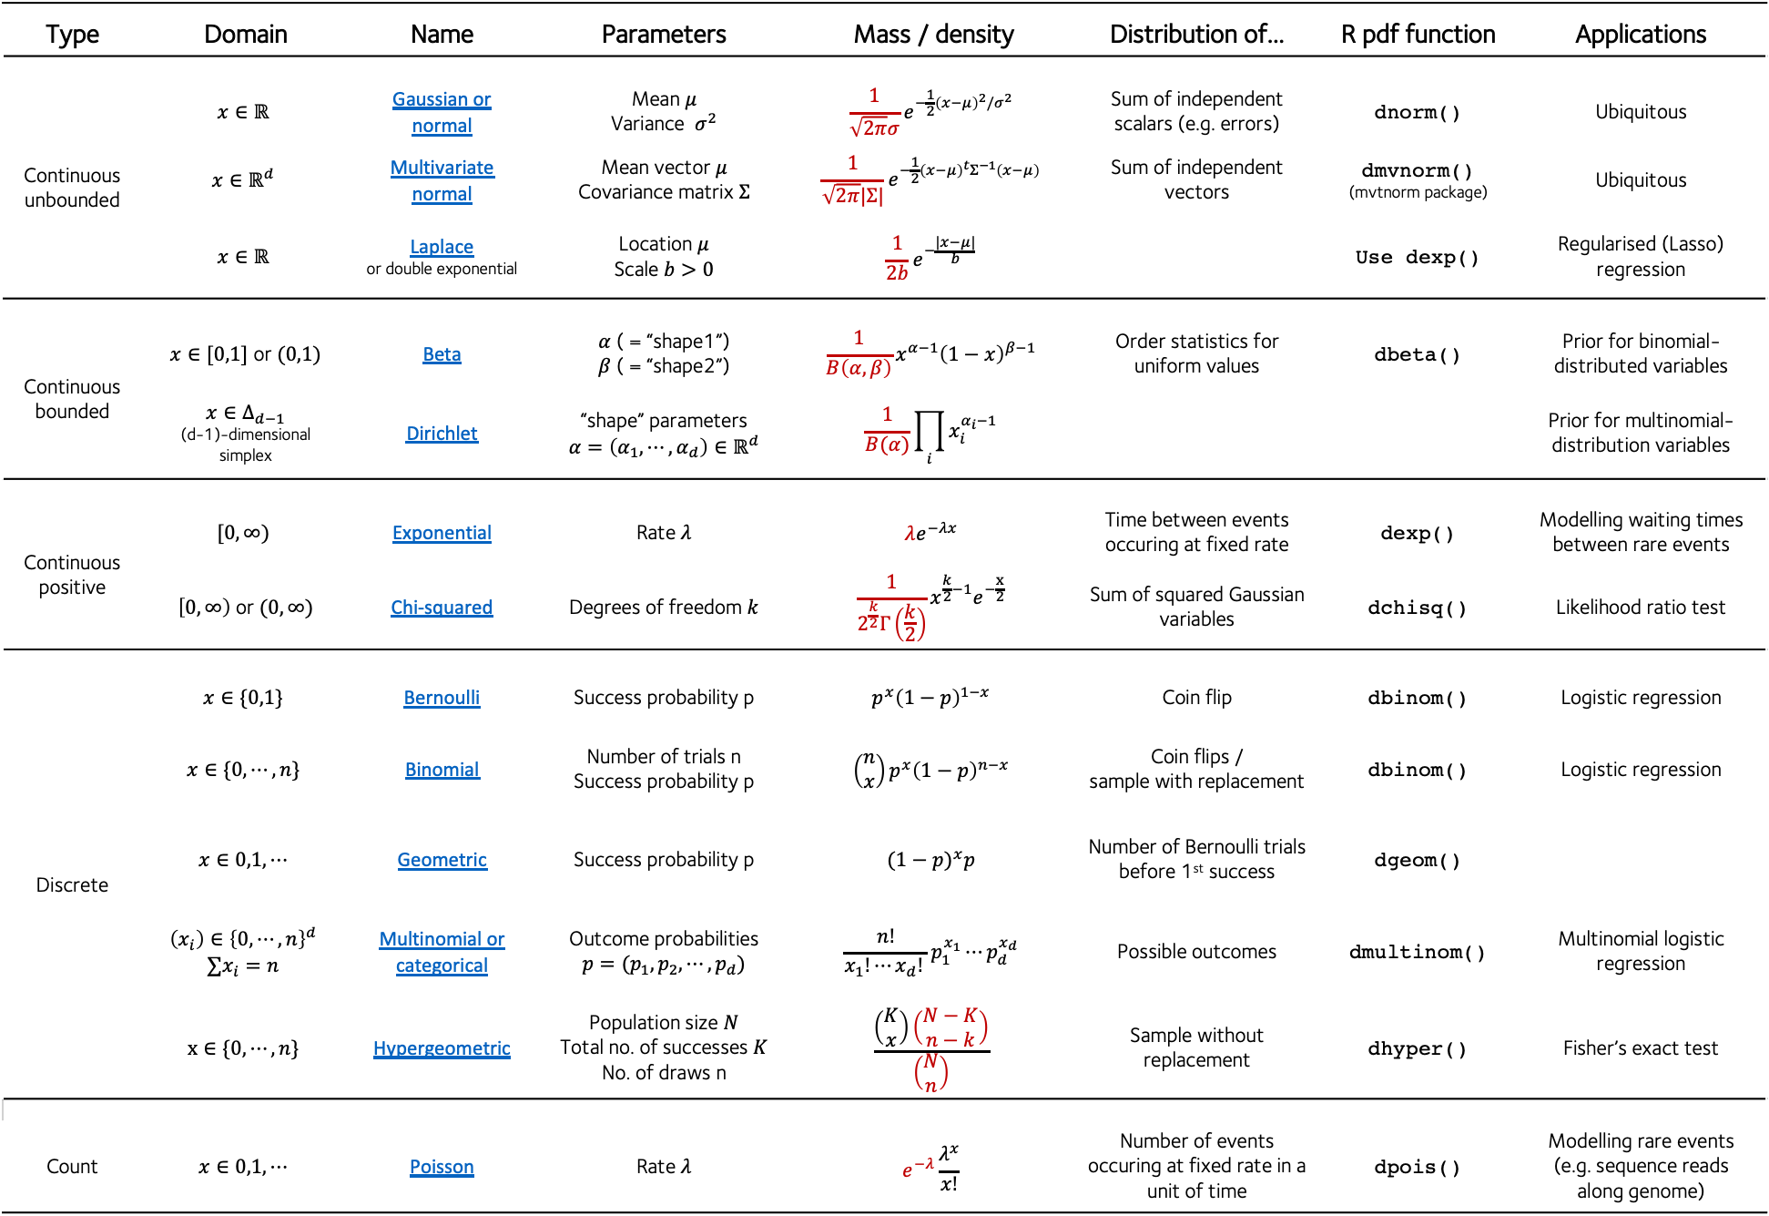
Distributions cheatsheet
$B$ = beta or multivariate beta function
$Γ$ = gamma function
See also: the distribution zoo
See also: A longer list of probability distributions
Gavin Band, WHG GMS Programme 2021
$\left(\begin{matrix}N \\ k\end{matrix}\right)$ = N choose k
Red terms are those that do not involve x
Type | Domain | Name | Parameters | Mass / density | Distribution of… | R pdf function | Applications
Continuous unbounded | $$x∈ℝ$$ | Gaussian or normal | Mean $μ$ Variance $σ^{2}$ | $$\frac{1}{\sqrt{2π}σ}e^{−\frac{1}{2}{\left(x−μ\right)}^{2}/σ^{2}}$$ | Sum of independent scalars (e.g. errors) | dnorm() | Ubiquitous
 | $${x∈ℝ}^{d}$$ | Multivariate normal | Mean vector $μ$ Covariance matrix $Σ$ | $$\frac{1}{\sqrt{2π}|Σ|}e^{−\frac{1}{2}{\left(x−μ\right)}^{t}Σ^{−1}\left(x−μ\right)}$$ | Sum of independent vectors | dmvnorm() (mvtnorm package) | Ubiquitous
 | $$x∈ℝ$$ | Laplace or double exponential | Location $μ$ Scale $b>0$ | $$\frac{1}{2b}e^{−\frac{|x−μ|}{b}}$$ |  | Use dexp() | Regularised (Lasso) regression
Continuous bounded | $x∈[0,1]$ or $(0,1)$ | Beta | $α$ ( = “shape1”) $β$ ( = “shape2”) | $$\frac{1}{B\left(α,β\right)}x^{α−1}{\left(1−x\right)}^{β−1}$$ | Order statistics for uniform values | dbeta() | Prior for binomial-distributed variables
 | $$x∈Δ_{d−1}$$ (d-1)-dimensional simplex | Dirichlet | “shape” parameters $$α=\left(α_{1},⋯,α_{d}\right)∈ℝ^{d}$$ | $$\frac{1}{B(α)}\prod_{i}{x_{i}^{α_{i}−1}}$$ |  |  | Prior for multinomial-distribution variables
Continuous positive | $$[0,∞)$$ | Exponential | Rate $λ$ | $$λe^{−λx}$$ | Time between events occuring at fixed rate | dexp() | Modelling waiting times between rare events
 | $\left[0,∞\right)$ or $(0,∞)$ | Chi-squared | Degrees of freedom $k$ | $$\frac{1}{2^{\frac{k}{2}}Γ\left(\frac{k}{2}\right)}x^{\frac{k}{2}−1}e^{−\frac{x}{2}}$$ | Sum of squared Gaussian variables | dchisq() | Likelihood ratio test
Discrete | $$x∈\{0,1\}$$ | Bernoulli | Success probability p | $$p^{x}{\left(1−p\right)}^{1−x}$$ | Coin flip | dbinom() | Logistic regression
 | $$x∈\{0,⋯,n\}$$ | Binomial | Number of trials n Success probability p | $$\left(\begin{matrix}n \\ x\end{matrix}\right)p^{x}{\left(1−p\right)}^{n−x}$$ | Coin flips / sample with replacement | dbinom() | Logistic regression
 | $$x∈0,1,⋯$$ | Geometric | Success probability p | $${(1−p)}^{x}p$$ | Number of Bernoulli trials before 1st success | dgeom()
 | $$\left(x_{i}\right)∈{\left\{0,⋯,n\right\}}^{d}$$ $$∑x_{i}=n$$ | Multinomial or categorical | Outcome probabilities $$p=(p_{1},p_{2},⋯,p_{d})$$ | $$\frac{n!}{x_{1}!⋯x_{d}! }p_{1}^{x_{1}}⋯p_{d}^{x_{d}}$$ | Possible outcomes | dmultinom() | Multinomial logistic regression
 | $$x∈\{0,⋯,n\}$$ | Hypergeometric | Population size $N$ Total no. of successes $K$ No. of draws n | $$\frac{\left(\begin{matrix}K \\ x\end{matrix}\right)\left(\begin{matrix}N−K \\ n−k\end{matrix}\right)}{\left(\begin{matrix}N \\ n\end{matrix}\right)}$$ | Sample without replacement | dhyper() | Fisher’s exact test
Count | $$x∈0,1,⋯$$ | Poisson | Rate $λ$ | $$e^{−λ}\frac{λ^{x}}{x!}$$ | Number of events occuring at fixed rate in a unit of time | dpois() | Modelling rare events (e.g. sequence reads along genome)

